Slide 2
x 1000 RPM
20
mph

Slide 3
x 1000 RPM
20
mph

Slide 4
N
x 1000 RPM
20
mph

Slide 5
0
20.1
mpg
x 1000 RPM
20
mph
20.4
ave

Slide 6
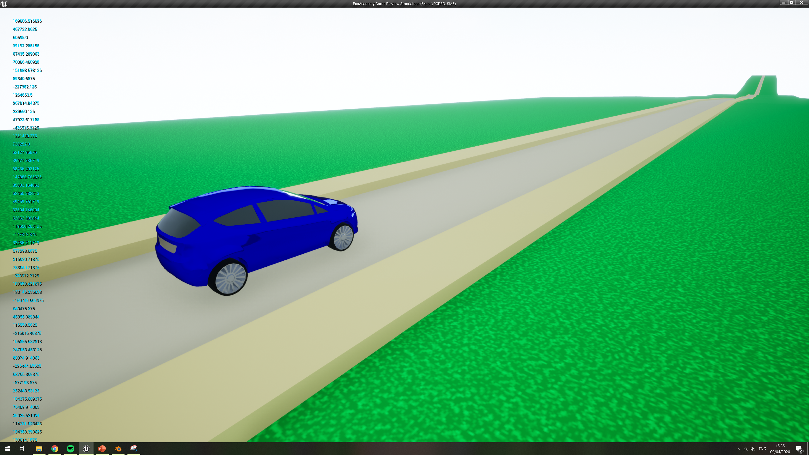
3
4
5
20.1
mpg
2
6
x 1000 RPM
1
7
STRT
FIN
20.4
avg
N
100
0
mph

Slide 7
3
4
5
20.1
mpg
2
6
x 1000 RPM
1
7
STRT
FIN
20.4
avg
100
0
mph

Slide 8
3
4
5
20.1
km / L
2
6
x 1000 RPM
1
7
STRT
FIN
20.4
avg
100
0
kph

Slide 9
3
4
5
20.1
mpg
2
6
x 1000 RPM
1
7
20.4
ave
4
0
0
mph

Slide 13
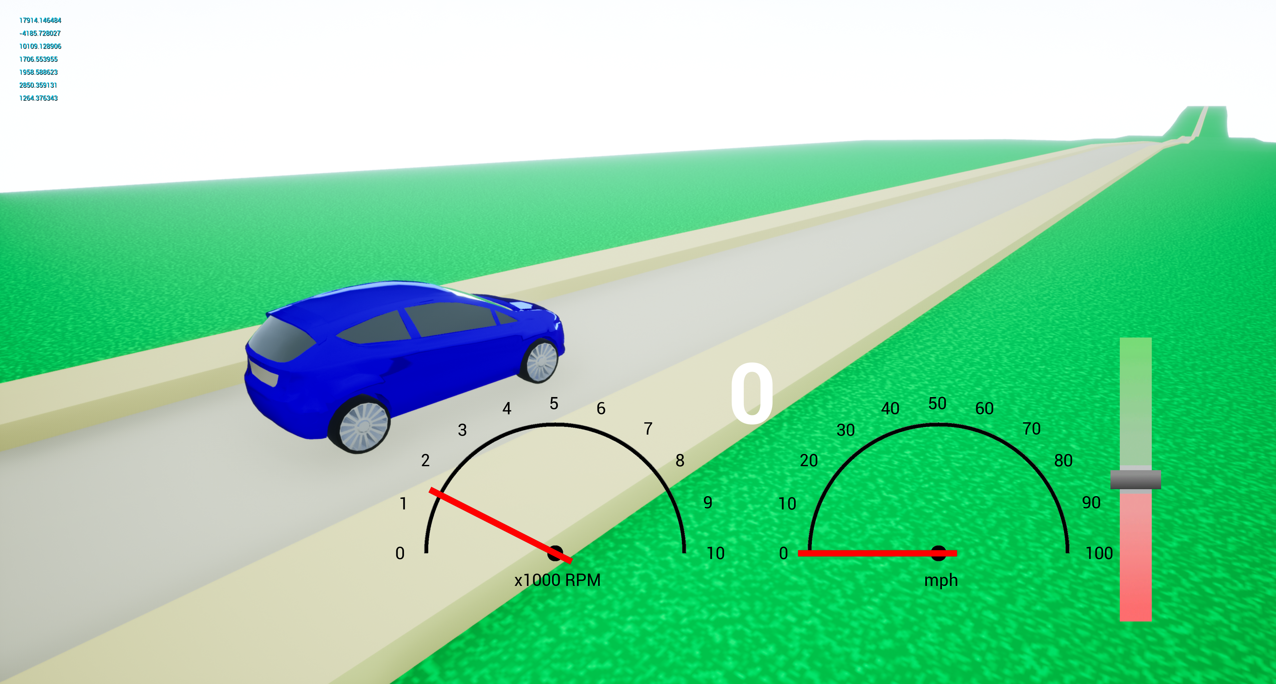
x 1000 RPM
20
mph

Slide 14
x 1000 RPM
20mpg
mph
N
20

Slide 15
20mpg
x 1000 RPM
mph
N
20

Slide 16
20mpg
N
20mph
x 1000 RPM

Slide 17
20mpg
20
mph
x 1000 RPM
N

Slide 18
20mpg
20
mph
x 1000 RPM
N

Slide 19
20mpg
20
mph
x 1000 RPM
N

Slide 20
N
x 1000 RPM
20
20mpg
mph

Slide 21
N
x 1000 RPM
20
20mpg
mph

Slide 22
N
x 1000 RPM
20
mph

Slide 23
3
4
5
20.1
mpg
2
6
x 1000 RPM
1
7
STRT
FIN
20.4
avg
N
100
0
mph

